Slide 1


Basic Details of the Team and Problem Statement
Codictive 1.0 State-Level Hackathon
PS Code: KVH-001
Problem Statement Title : New Age Women Safety App.
Team Name : Bug-Bytes
Team Leader Name : Anuj Raghuwanshi
Institute Name : Bansal Institute of Science and Technology
Theme Name: Social Impact and Welfare

Slide 2

Approach Details
If the app detects danger(Through AI or Manually) it will first give a strong vibration for cancellation of danger, if not confirmed it will keep on sending alerts to nearby police stations and hospitals, assigned emergency contacts, police patrolling vans and nearby patrolling vans with live location, audio, camera recordings in compressed form to save internet data.
If the app is activated someone and tries to TURNOFF the phone, built-in Fake power off mode will get activated and the phone will pretend to turn off but will actively send location, images, camera samples to assigned contacts.
The app is designed to Optimise Battery, it is designed to save battery and for safety in case of low battery it will give warning and at 10% remaining battery it will freeze all other apps except caller, messaging & App itself.
Apart from all these the app will have separate Mode Selection, it will have the following modes :-
Cab Mode : The details of the Vehicle and Driver can be sent to custom contacts by scanning the QR code of Cab, it will also show the safest route of your destination and if diverted from the route will notify your selected contacts.
Anjaan Mode : To protect women against harassment and molesting the app will provide a separate mode which will support fake calls and messaging feature which can be activated manually or by voice activation the calls or messages can be pre-recorded to sound much realistic.
Saheli Mode : To make them aware of the rights, laws and acts of government the app will have all these in text, audio or video format, to motivate it will have real life incidents in text or on Podcast as well as it will have some self defence techniques and tips.
Problem summary : Design and develop a Women Safety App that automatically senses the danger to a mobile user and triggers an SOS alert with location details based on multimodal data from a mobile device such as audio, video, image, motion detection etc., given a situation that the user is not able to operate the mobile
Building an AI based app NIVEDITA which will protect Women against crime and provide them safety.
The app will need permissions from User for it’s functioning and tracking(like camera, contacts, microphone, GPS, storage, modify system settings, battery optimisation )
After successfully registering the app with Aadhar card, Phone No. , Biometrics it will start monitoring and implement it’s safety measures.
Based on user’s current location and the crime records in that area the app will categorize the area in Heat Zones.
The app will start monitoring as per the heat zone automatically, as if the user is in Safe zone(will monitor passively), Moderate zone (will monitor actively), Severe zone (will monitor actively with a warning to user’s contacts) and if in No Network zone an alert with the last active location will be sent to emergency contacts by SOS.
The app will go to Activation through users voice keyword, If dropped or fell, shaken vigorously, through custom gestures, or in an unknown location for long and not confirmed, Through volume/power button.

Slide 3
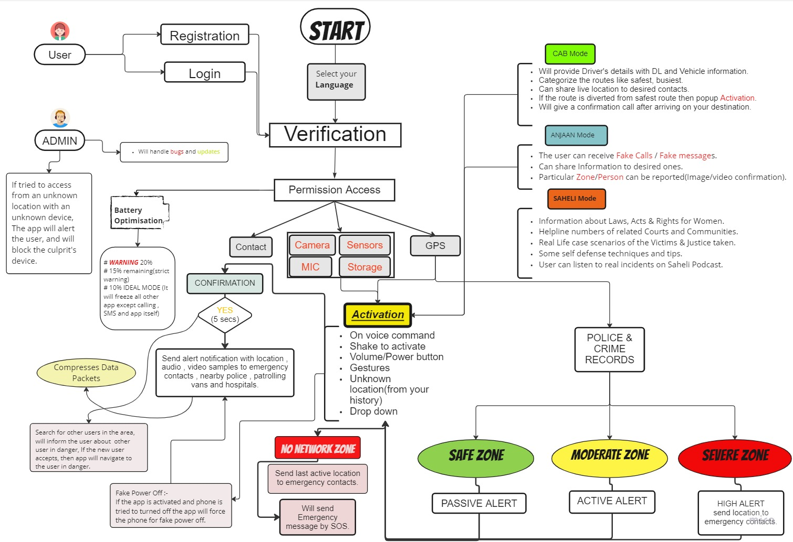
FLOW CHART

Slide 4
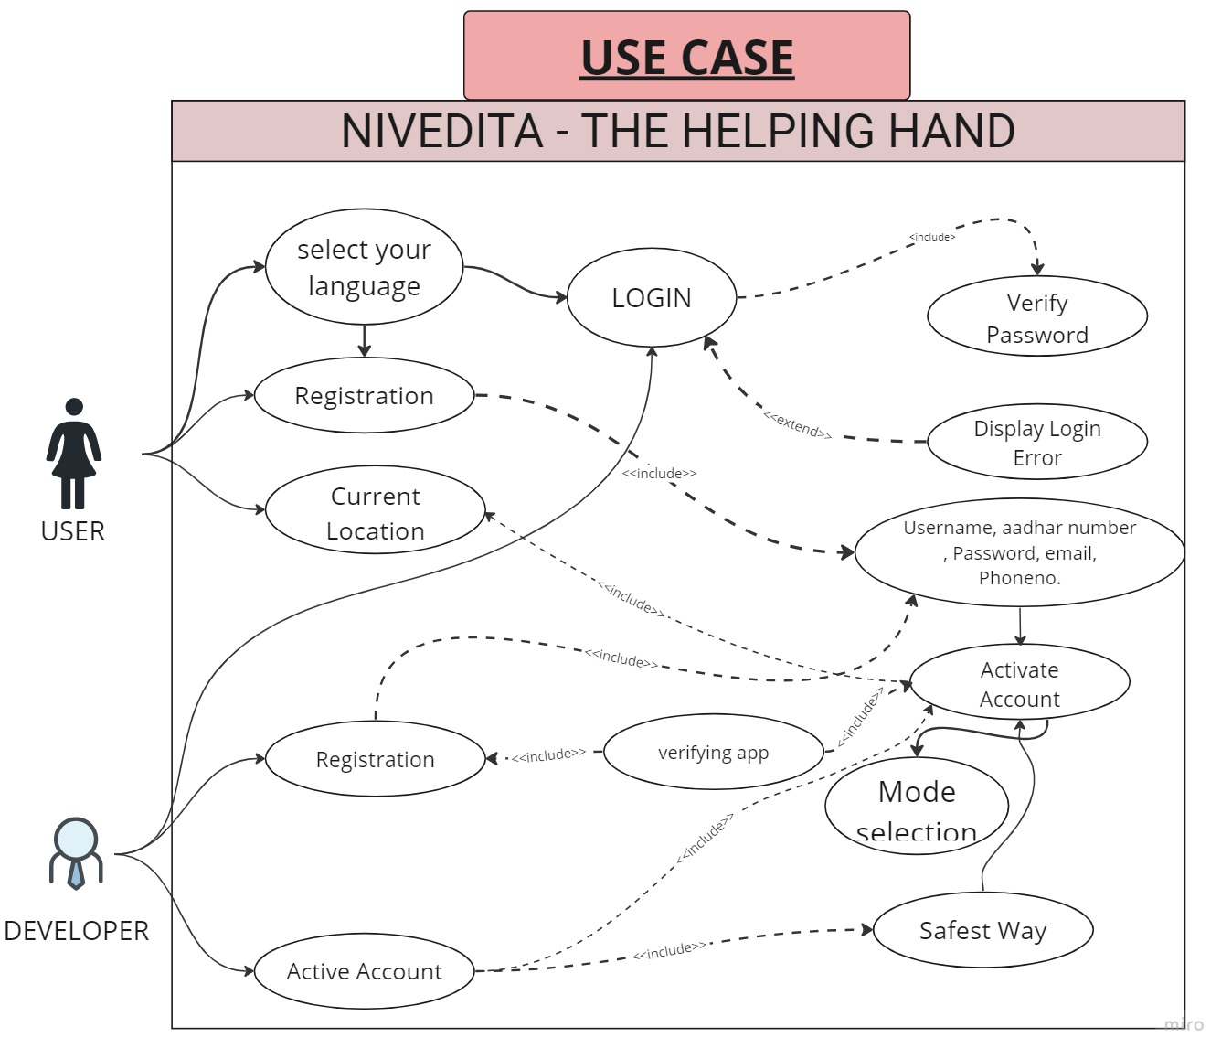
Technology Stack :
Frontend - JavaScript
Backend – Python, AI
Data Base – MySQL, Cloud computing
Framework - Django
Stoppers & Dependencies :
Smartphone is mandatory.
Network Glitch.
Network Traffic.
Data Scaricity.
.

Slide 5
APP PORTFOLIO :

Slide 6
Team Member Details
Team Leader Name: Anuj Raghuwanshi
Branch : B. Tech Stream : CSE Year : II
Team Member 1 Name : Chitransh Singh
Branch : B. Tech Stream : CSE Year : II
Team Member 2 Name : Drishti Bajpeyi
Branch : B. Tech Stream : CSE Year : II
Team Member 3 Name : Ayush Pandey
Branch : B. Tech Stream : CSE Year : II
Team Member 4 Name : Abhishek Kumar
Branch : B. Tech Stream : CSE Year : II
Team Member 5 Name : Himani Sujane
Branch : B. Tech Stream : CSE Year : II
Team Mentor 1 Name: Dr. Kailash Patidar
Category : Academic Expertise : Data Mining Domain Experience : 12+ years
Team Mentor 2 Name: Prof. Jyoti Prajapati
Category : Training & Placement Expertise : Python, MySQL, DSA Domain Experience : 7+ years

